Slide 1
Cryptography and Network Security
Chapter 13
Fifth Edition
by William Stallings
Notes:
Lecture slides by Lawrie Brown for “Cryptography and Network Security”, 5/e, by William Stallings, Chapter 13 – “Digital Signatures”.

Slide 2
Digital Signature Standard (DSS)
US Govt approved signature scheme
designed by NIST & NSA in early 90's
published as FIPS-186 in 1991
revised in 1993, 1996 & then 2000
uses the SHA hash algorithm
DSS is the standard, DSA is the algorithm
FIPS 186-2 (2000) includes alternative RSA & elliptic curve signature variants
DSA is digital signature only unlike RSA
is a public-key technique
Notes:
DSA is the US Govt approved signature scheme, which is designed to provide strong signatures without allowing easy use for encryption. The National Institute of Standards and Technology (NIST) published Federal Information Processing Standard FIPS 186, known as the Digital Signature Standard (DSS). The DSS makes use of the Secure Hash Algorithm (SHA) described in Chapter 12 and presents a new digital signature technique, the Digital Signature Algorithm (DSA). The DSS was originally proposed in 1991 and revised in 1993 in response to public feedback concerning the security of the scheme. There was a further minor revision in 1996. In 2000, an expanded version of the standard was issued as FIPS 186-2. This latest version also incorporates digital signature algorithms based on RSA and on elliptic curve cryptography. In this section, we discuss the original DSS algorithm. The DSS uses an algorithm that is designed to provide only the digital signature function. Unlike RSA, it cannot be used for encryption or key exchange. Nevertheless, it is a public-key technique.

Slide 3
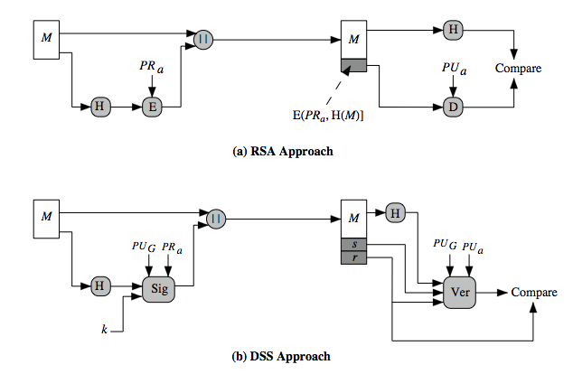
DSS vs RSA Signatures
Notes:
Stallings Figure 13.3 contrasts the DSS approach for generating digital signatures to that used with RSA. In the RSA approach, the message to be signed is input to a hash function that produces a secure hash code of fixed length. This hash code is then encrypted using the sender's private key to form the signature. Both the message and the signature are then transmitted. The recipient takes the message and produces a hash code. The recipient also decrypts the signature using the sender's public key. If the calculated hash code matches the decrypted signature, the signature is accepted as valid. Because only the sender knows the private key, only the sender could have produced a valid signature. The DSS approach also makes use of a hash function. The hash code is provided as input to a signature function along with a random number k generated for this particular signature. The signature function also depends on the sender's private key (PR _{a}) and a set of parameters known to a group of communicating principals. We can consider this set to constitute a global public key (PU_{G}). The result is a signature consisting of two components, labeled s and r. At the receiving end, the hash code of the incoming message is generated. This plus the signature is input to a verification function. The verification function also depends on the global public key as well as the sender's public key (PU_{a}), which is paired with the sender's private key. The output of the verification function is a value that is equal to the signature component r if the signature is valid. The signature function is such that only the sender, with knowledge of the private key, could have produced the valid signature.

Slide 4
Digital Signature Algorithm (DSA)
creates a 320 bit signature
with 512-1024 bit security
smaller and faster than RSA
a digital signature scheme only
security depends on difficulty of computing discrete logarithms
variant of ElGamal & Schnorr schemes
Notes:
The DSA is based on the difficulty of computing discrete logarithms (see Chapter 8) and is based on schemes originally presented by ElGamal [ELGA85] and Schnorr [SCHN91]. The DSA signature scheme has advantages, being both smaller (320 vs 1024bit) and faster (much of the computation is done modulo a 160 bit number), over RSA. Unlike RSA, it cannot be used for encryption or key exchange. Nevertheless, it is a public-key technique

Slide 5
DSA Key Generation
have shared global public key values (p,q,g):
  choose 160-bit prime number q
  choose a large prime p with 2^{L-1} < p < 2^{L}
    where L= 512 to 1024 bits and is a multiple of 64
    such that q is a 160 bit prime divisor of (p-1)
  choose g = h^{(p-1)/q}
    where 1<h<p-1 and h^{(p-1)/q} mod p > 1
users choose private & compute public key:
  choose random private key: x<q
  compute public key: y = g^{x} mod p
Notes:
DSA typically uses a common set of global parameters (p,q,g) for a community of clients, as shown. A 160-bit prime number q is chosen. Next, a prime number p is selected with a length between 512 and 1024 bits such that q divides (p – 1). Finally, g is chosen to be of the form h^{(p–1)/q} mod p where h is an integer between 1 and (p – 1) with the restriction that g must be greater than 1. Thus, the global public key components of DSA have the same for as in the Schnorr signature scheme.
Then each DSA uses chooses a random private key x, and computes their public key as shown. The calculation of the public key y given x is relatively straightforward. However, given the public key y, it is computationally infeasible to determine x, which is the discrete logarithm of y to base g, mod p.

Slide 6
DSA Signature Creation
to sign a message M the sender:
  generates a random signature key k, k<q
  nb. k must be random, be destroyed after use, and never be reused
then computes signature pair:
  r = (g^{k} mod p)mod q
  s = [k⁻¹(H(M)+ xr)] mod q
sends signature (r,s) with message M
Notes:
To create a signature, a user calculates two quantities, r and s, that are functions of the public key components (p,q,g), the user’s private key (x), the hash code of the message H(M), and an additional integer k that should be generated randomly or pseudo-randomly and be unique for each signing. This is similar to ElGamal signatures, with the use of a per message temporary signature key k, but doing calculations first mod p, then mod q to reduce the size of the result. The signature (r,s) is then sent with the message to the recipient. Note that computing r only involves calculation mod p and does not depend on message, hence can be done in advance. Similarly with randomly choosing k’s and computing their inverses.

Slide 7
DSA Signature Verification
having received M & signature (r,s)
to verify a signature, recipient computes:
  w = s⁻¹ mod q
  u1= [H(M)w ]mod q
  u2= (rw)mod q
  v = [(g^{u1} y^{u2})mod p ]mod q
if v=r then signature is verified
see Appendix A for details of proof why
Notes:
At the receiving end, verification is performed using the formulas shown. The receiver generates a quantity v that is a function of the public key components, the sender’s public key, and the hash of the incoming message. If this quantity matches the r component of the signature, then the signature is validated. Note that the difficulty of computing discrete logs is why it is infeasible for an opponent to recover k from r, or x from s. Note also that nearly all the calculations are mod q, and hence are much faster save for the last step.
The structure of this function is such that the receiver can recover r using the incoming message and signature, the public key of the user, and the global public key. It is certainly not obvious that such a scheme would work. A proof is provided in Stallings appendix K.

Slide 8
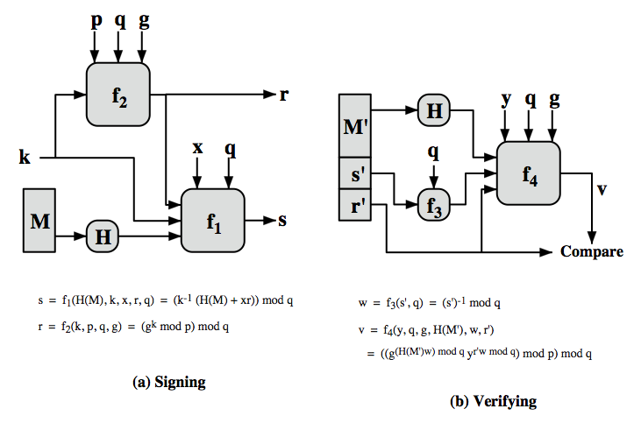
DSS Overview
Notes:
Stallings Figure 13.5 depicts the functions of signing and verifying. The structure of the algorithm, as revealed here is quite interesting. Note that the test at the end is on the value r, which does not depend on the message at all. Instead, r is a function of k and the three global public-key components. The multiplicative inverse of k (mod q) is passed to a function that also has as inputs the message hash code and the user's private key. The structure of this function is such that the receiver can recover r using the incoming message and signature, the public key of the user, and the global public key.

Slide 9
Cryptography and Network Security
Chapter 14
Fifth Edition
by William Stallings
Notes:
Lecture slides by Lawrie Brown for “Cryptography and Network Security”, 5/e, by William Stallings, Chapter 14 – “Key Management and Distribution”.

Slide 10
Key Management and Distribution
topics of cryptographic key management / key distribution are complex
  cryptographic, protocol, & management issues
symmetric schemes require both parties to share a common secret key
public key schemes require parties to acquire valid public keys
have concerns with doing both
Notes:
The topics of cryptographic key management and cryptographic key distribution are complex, involving cryptographic, protocol, and management considerations. The purpose of this chapter is to give the reader a feel for the issues involved and a broad survey of the various aspects of key management and distribution.

Slide 11
Key Distribution
symmetric schemes require both parties to share a common secret key
issue is how to securely distribute this key
whilst protecting it from others
frequent key changes can be desirable
often secure system failure due to a break in the key distribution scheme
Notes:
For symmetric encryption to work, the two parties to an exchange must share the same key, and that key must be protected from access by others. Furthermore, frequent key changes are usually desirable to limit the amount of data compromised if an attacker learns the key. This is one of the most critical areas in security systems - on many occasions systems have been broken, not because of a poor encryption algorithm, but because of poor key selection or management. It is absolutely critical to get this right!

Slide 12
Key Distribution
given parties A and B have various key distribution alternatives:
  A can select key and physically deliver to B
  third party can select & deliver key to A & B
  if A & B have communicated previously can use previous key to encrypt a new key
  if A & B have secure communications with a third party C, C can relay key between A & B
Notes:
The strength of any cryptographic system thus depends on the key distribution technique. For two parties A and B, key distribution can be achieved in a number of ways:
Physical delivery (1 & 2) is simplest - but only applicable when there is personal contact between recipient and key issuer. This is fine for link encryption where devices & keys occur in pairs, but does not scale as number of parties who wish to communicate grows (see next slide). 3 is mostly based on 1 or 2 occurring first, and also suffers that if an attacker ever succeeds in gaining access to one key, then all subsequent keys will be revealed.
A third party, whom all parties trust, can be used as a trusted intermediary to mediate the establishment of secure communications between them (4). Must trust intermediary not to abuse the knowledge of all session keys. As number of parties grow, some variant of 4 is only practical solution to the huge growth in number of keys potentially needed.

Slide 13
Key Hierarchy
typically have a hierarchy of keys
session key
  temporary key
  used for encryption of data between users
  for one logical session then discarded
master key
  used to encrypt session keys
  shared by user & key distribution center
Notes:
For end-to-end encryption, some variation on option 4 has been widely adopted. In this scheme, a key distribution center is responsible for distributing keys to pairs of users (hosts, processes, applications) as needed. Each user must share a unique key with the key distribution center for purposes of key distribution. The use of a key distribution center is based on the use of a hierarchy of keys. At a minimum, two levels of keys are used: a session key, used for the duration of a logical connection; and a master key shared by the key distribution center and an end system or user and used to encrypt the session key.

Slide 14
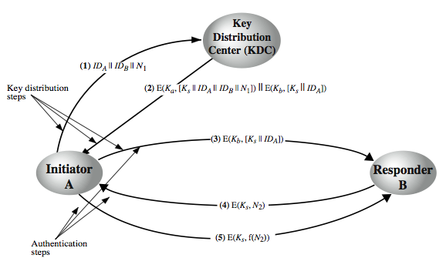
Key Distribution Scenario
Notes:
The key distribution concept can be deployed in a number of ways. A typical scenario is illustrated in Stallings Figure 14.3 above, which has a “Key Distribution Center” (KDC) which shares a unique key with each party (user). The text in section 14.1 details the steps needed, which are briefly:
1. A requests from the KDC a session key to protect a logical connection to B. The message includes the identity of A and B and a unique nonce N1.
2. The KDC responds with a message encrypted using Ka that includes a one-time session key Ks to be used for the session, the original request message to enable A to match response with appropriate request, and info for B
3. A stores the session key for use in the upcoming session and forwards to B the information from the KDC for B, namely, E(Kb, [Ks || IDA]). Because this information is encrypted with Kb, it is protected from eavesdropping.
At this point, a session key has been securely delivered to A and B, and they may begin their protected exchange. Two additional steps are desirable:
4. Using the new session key for encryption B sends a nonce N2 to A.
5. Also using Ks, A responds with f(N2), where f is a function that performs some transformation on N2 (eg. adding one). These steps assure B that the original message it received (step 3) was not a replay. Note that the actual key distribution involves only steps 1 through 3 but that steps 4 and 5, as well as 3, perform an authentication function.

Slide 15
Key Distribution Issues
hierarchies of KDC’s required for large networks, but must trust each other
session key lifetimes should be limited for greater security
use of automatic key distribution on behalf of users, but must trust system
use of decentralized key distribution
controlling key usage
Notes:
Briefly note here some of the major issues associated with the use of Key Distribution Centers (KDC’s).
For very large networks, a hierarchy of KDCs can be established. For communication among entities within the same local domain, the local KDC is responsible for key distribution. If two entities in different domains desire a shared key, then the corresponding local KDCs can communicate through a (hierarchy of) global KDC(s)
To balance security & effort, a new session key should be used for each new connection-oriented session. For a connectionless protocol, a new session key is used for a certain fixed period only or for a certain number of transactions.
An automated key distribution approach provides the flexibility and dynamic characteristics needed to allow a number of terminal users to access a number of hosts and for the hosts to exchange data with each other, provided they trust the system to act on their behalf.
The use of a key distribution center imposes the requirement that the KDC be trusted and be protected from subversion. This requirement can be avoided if key distribution is fully decentralized.
In addition to separating master keys from session keys, may wish to define different types of session keys on the basis of use.
These issues are discussed in more detail in the text Stallings section 14.1.

Slide 16
Symmetric Key Distribution Using Public Keys
public key cryptosystems are inefficient
  so almost never use for direct data encryption
  rather use to encrypt secret keys for distribution
Notes:
Because of the inefficiency of public key cryptosystems, they are almost never used for the direct encryption of sizable block of data, but are limited to relatively small blocks. One of the most important uses of a public key cryptosystem is to encrypt secret keys for distribution. We see many specific examples of this later in the text.

Slide 17
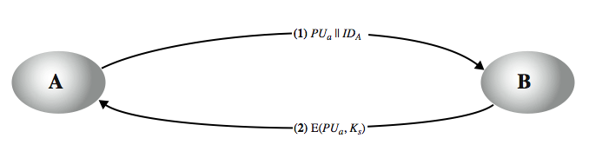
Simple Secret Key Distribution
Merkle proposed this very simple scheme
  allows secure communications
  no keys before/after exist
Notes:
An extremely simple scheme was put forward by Merkle from Stallings Figure 14.7. If A wishes to communicate with B, the following procedure is employed:
A generates a public/private key pair {PUa, PRa} and transmits a message to B consisting of PUa and an identifier of A, IDA.
B generates a secret key, Ks, and transmits it to A, encrypted with A's public key.
A computes D(PRa, E(PUa, Ks)) to recover the secret key. Because only A can decrypt the message, only A and B will know the identity of Ks.
A discards PUa and PRa and B discards PUa.
A and B can now securely communicate using conventional encryption and the session key Ks. At the completion of the exchange, both A and B discard Ks. Despite its simplicity, this is an attractive protocol. No keys exist before the start of the communication and none exist after the completion of communication. Thus, the risk of compromise of the keys is minimal. At the same time, the communication is secure from eavesdropping.

Slide 18
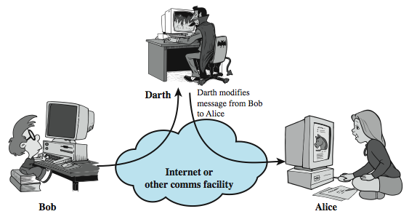
Man-in-the-Middle Attack
this very simple scheme is vulnerable to an active man-in-the-middle attack
Notes:
The protocol depicted in Figure 14.7 is insecure against an adversary who can intercept messages and then either relay the intercepted message or substitute another message (see Stallings Figure 1.3c). Such an attack is known as a man-in-the-middle attack. In this case, if an adversary, E, has control of the intervening communication channel, then E can compromise the communication in the following fashion without being detected:
A generates a public/private key pair {PUa, PRa} and transmits a message intended for B consisting of PUa and an identifier of A, IDA.
E intercepts the message, creates its own public/private key pair {PUe, PRe} and transmits PUe || IDA to B.
B generates a secret key, Ks, and transmits E(PUe, Ks).
E intercepts the message and learns Ks by computing D(PRe, E(PUe, Ks)).
E transmits E(PUa, Ks) to A.
The result is that both A and B know Ks and are unaware that Ks has also been revealed to E. A and B can now exchange messages using Ks. E no longer actively interferes with the communications channel but simply eavesdrops. Knowing Ks, E can decrypt all messages, and both A and B are unaware of the problem. Thus, this simple protocol is only useful in an environment where the only threat is eavesdropping.

Slide 19
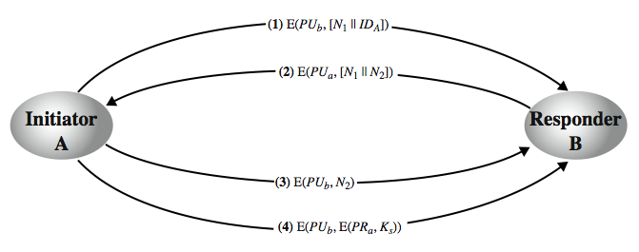
Secret Key Distribution with Confidentiality and Authentication
Notes:
Stallings Figure 14.8, based on an approach suggested in [NEED78], provides protection against both active and passive attacks. Assuming A and B have exchanged public keys by one of the schemes described subsequently in this chapter, then the following steps occur:
A uses B's public key to encrypt a message to B containing an identifier of A (IA) and a nonce (N1), which is used to identify this transaction uniquely.
B sends a message to A encrypted with PUa and containing A's nonce (N1) as well as a new nonce generated by B (N2). Because only B could have decrypted message (1), the presence of N1 in message (2) assures A that the correspondent is B.
A returns N2, encrypted using B's public key, to assure B that its correspondent is A.
A selects a secret key Ks and sends M = E(PUb, E(PRa, Ks)) to B. Encryption with B's public key ensures that only B can read it; encryption with A's private key ensures that only A could have sent it.
B computes D(PUa, D(PRb, M)) to recover the secret key.
The result is that this scheme ensures both confidentiality and authentication in the exchange of a secret key.

Slide 20
Distribution of Public Keys
can be considered as using one of:
  public announcement
  publicly available directory
  public-key authority
  public-key certificates
Notes:
Several techniques have been proposed for the distribution of public keys, which can mostly be grouped into the categories shown.

Slide 21
Public Announcement
users distribute public keys to recipients or broadcast to community at large
  eg. append PGP keys to email messages or post to news groups or email list
major weakness is forgery
  anyone can create a key claiming to be someone else and broadcast it
  until forgery is discovered can masquerade as claimed user
Notes:
The point of public-key encryption is that the public key is public, hence any participant can send his or her public key to any other participant, or broadcast the key to the community at large. Its major weakness is forgery, anyone can create a key claiming to be someone else and broadcast it, and until the forgery is discovered they can masquerade as the claimed user.

Slide 22
Publicly Available Directory
can obtain greater security by registering keys with a public directory
directory must be trusted with properties:
  contains {name,public-key} entries
  participants register securely with directory
  participants can replace key at any time
  directory is periodically published
  directory can be accessed electronically
still vulnerable to tampering or forgery
Notes:
A greater degree of security can be achieved by maintaining a publicly available dynamic directory of public keys. Maintenance and distribution of the public directory would have to be the responsibility of some trusted entity or organization. This scheme is clearly more secure than individual public announcements but still has vulnerabilities to tampering or forgery.

Slide 23
Public-Key Authority
improve security by tightening control over distribution of keys from directory
has properties of directory
and requires users to know public key for the directory
then users interact with directory to obtain any desired public key securely
  does require real-time access to directory when keys are needed
  may be vulnerable to tampering
Notes:
Stronger security for public-key distribution can be achieved by providing tighter control over the distribution of public keys from the directory. It requires users to know the public key for the directory, and that they interact with directory in real-time to obtain any desired public key securely. This scenario is attractive, yet it has some drawbacks. The public-key authority could be somewhat of a bottleneck in the system, for a user must appeal to the authority for a public key for every other user that it wishes to contact. As before, the directory of names and public keys maintained by the authority is vulnerable to tampering.

Slide 24
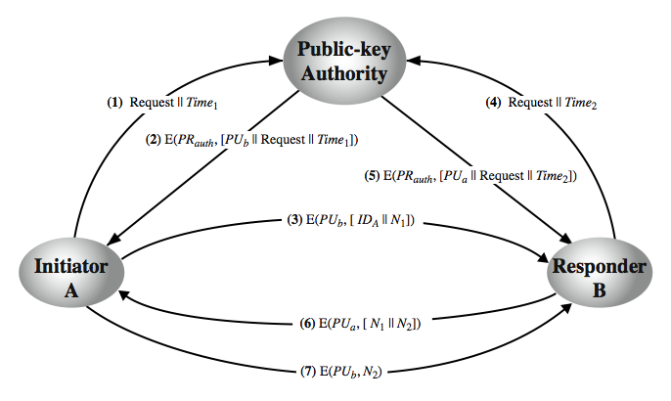
Public-Key Authority
Notes:
Stallings Figure 14.11 “Public-Key Authority” illustrates a typical protocol interaction. As before, the scenario assumes that a central authority maintains a dynamic directory of public keys of all participants. In addition, each participant reliably knows a public key for the authority, with only the authority knowing the corresponding private key. See text for details of steps in protocol. A total of seven messages are required. However, the initial four messages need be used only infrequently because both A and B can save the other's public key for future use, a technique known as caching. Periodically, a user should request fresh copies of the public keys of its correspondents to ensure currency.

Slide 25
Public-Key Certificates
certificates allow key exchange without real-time access to public-key authority
a certificate binds identity to public key
  usually with other info such as period of validity, rights of use etc
with all contents signed by a trusted Public-Key or Certificate Authority (CA)
can be verified by anyone who knows the public-key authorities public-key
Notes:
An further improvement, first suggested by Kohnfelder, is to use certificates, which can be used to exchange keys without contacting a public-key authority, in a way that is as reliable as if the keys were obtained directly from a public-key authority. A certificate binds an identity to public key, with all contents signed by a trusted Public-Key or Certificate Authority (CA). A user can present his or her public key to the authority in a secure manner, and obtain a certificate. The user can then publish the certificate. Anyone needing this user's public key can obtain the certificate and verify that it is valid by way of the attached trusted signature. A participant can also convey its key information to another by transmitting its certificate. Other participants can verify that the certificate was created by the authority, provided they know its public key.
One scheme has become universally accepted for formatting public-key certificates: the X.509 standard. X.509 certificates are used in most network security applications, including IP security, secure sockets layer (SSL), secure electronic transactions (SET), and S/MIME. Will discuss it in much more detail later.

Slide 26
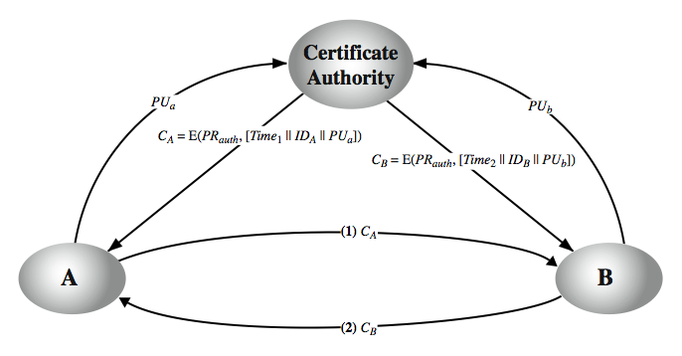
Public-Key Certificates
Notes:
A certificate scheme is illustrated in Stallings Figure 14.12. Each participant applies to the certificate authority, supplying a public key and requesting a certificate. Application must be in person or by some form of secure authenticated communication. For participant A, the authority provides a certificate CA. A may then pass this certificate on to any other participant, who can read and verify the certificate by verifying the signature from the certificate authority. Because the certificate is readable only using the authority's public key, this verifies that the certificate came from the certificate authority. The timestamp counters the following scenario. A's private key is learned by an adversary. A generates a new private/public key pair and applies to the certificate authority for a new certificate. Meanwhile, the adversary replays the old certificate to B. If B then encrypts messages using the compromised old public key, the adversary can read those messages. In this context, the compromise of a private key is comparable to the loss of a credit card. The owner cancels the credit card number but is at risk until all possible communicants are aware that the old credit card is obsolete. Thus, the timestamp serves as something like an expiration date. If a certificate is sufficiently old, it is assumed to be expired.
One scheme has become universally accepted for formatting public-key certificates: the X.509 standard.

Slide 27
X.509 Authentication Service
part of CCITT X.500 directory service standards
  distributed servers maintaining user info database
defines framework for authentication services
  directory may store public-key certificates
  with public key of user signed by certification authority
also defines authentication protocols
uses public-key crypto & digital signatures
  algorithms not standardised, but RSA recommended
X.509 certificates are widely used
  have 3 versions
Notes:
X.509 is part of the X.500 series of recommendations that define a directory service, being a server or distributed set of servers that maintains a database of information about users.
X.509 defines a framework for the provision of authentication services by the X.500 directory to its users. The directory may serve as a repository of public-key certificates. In addition, X.509 defines alternative authentication protocols based on the use of public-key certificates. X.509 is based on the use of public-key cryptography and digital signatures. The standard does not dictate the use of a specific algorithm but recommends RSA.
The X.509 certificate format is widely used, in for example S/MIME, IP Security and SSL/TLS and SET.
X.509 was initially issued in 1988. The standard was subsequently revised to address some of the security concerns; a revised recommendation was issued in 1993. A third version was issued in 1995 and revised in 2000.

Slide 28
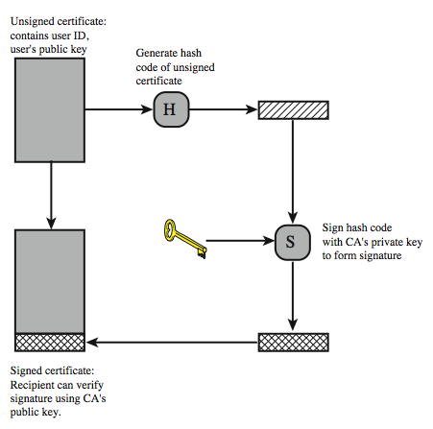
X.509 Certificate Use
Notes:
X.509 is based on the use of public-key cryptography and digital signatures. The standard does not dictate the use of a specific algorithm but recommends RSA. The digital signature scheme is assumed to require the use of a hash function. Again, the standard does not dictate a specific hash algorithm. The 1988 recommendation included the description of a recommended hash algorithm; this algorithm has since been shown to be insecure and was dropped from the 1993 recommendation. Stallings Figure 14.13 illustrates the generation of a public-key certificate.

Slide 29
X.509 Certificates
issued by a Certification Authority (CA), containing:
  version V (1, 2, or 3)
  serial number SN (unique within CA) identifying certificate
  signature algorithm identifier AI
  issuer X.500 name CA)
  period of validity TA (from - to dates)
  subject X.500 name A (name of owner)
  subject public-key info Ap (algorithm, parameters, key)
  issuer unique identifier (v2+)
  subject unique identifier (v2+)
  extension fields (v3)
  signature (of hash of all fields in certificate)
notation CA<<A>> denotes certificate for A signed by CA
Notes:
The heart of the X.509 scheme is the public-key certificate associated with each user. There are 3 versions, with successively more info in the certificate - must be v2 if either unique identifier field exists, must be v3 if any extensions are used. These user certificates are assumed to be created by some trusted certification authority (CA) and placed in the directory by the CA or by the user. The directory server itself is not responsible for the creation of public keys or for the certification function; it merely provides an easily accessible location for users to obtain certificates. The certificate includes the elements shown, see text for further details.
The standard uses the notation for a certificate of: CA<<A>> where the CA signs the certificate for user A with its private key. In more detail CA<<A>> = CA {V, SN, AI, CA, UCA, A, UA, Ap, TA}. If the corresponding public key is known to a user, then that user can verify that a certificate signed by the CA is valid. This is the typical digital signature approach illustrated in Stallings Figure 13.2.

Slide 30
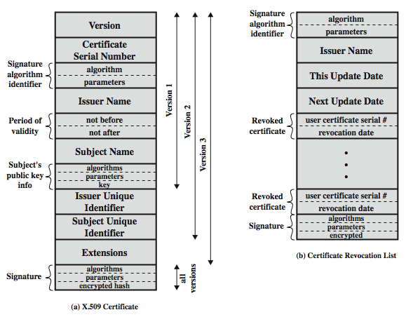
X.509 Certificates
Notes:
Stallings Figure 14.4 shows the format of an X.509 certificate and CRL (see later).

Slide 31
Cryptography and Network Security
Chapter 15
Fifth Edition
by William Stallings
Notes:
Lecture slides by Lawrie Brown for “Cryptography and Network Security”, 5/e, by William Stallings, Chapter 15 – “User Authentication”.

Slide 32
Kerberos
Kerberos is an authentication service developed in MIT.
There are two versions
  version 4 (developed in 1988) is still in common use
  version 5 (1994) corrects some security deficiencies of version 4 and has been issued a draft internet standard (RFC 1510)
The problem that Kerberos addresses is this:
”In an open distributed environment users at workstations wish to access services on servers distributed throughout the network. The servers must be able to restrict access to authorized users and be able to authenticate requests for service.”
In this environment a workstation can not be trusted to identify users correctly
  A user may gain access to a particular workstation and pretend to be another user operationg from that workstation
  A user may alter the network address of a workstation and thus impersonate another workstation
  A user may eavesdrop on exchanges and use a replay attack to gain entrance to a server

Slide 33
Kerberos
Rather than building in elaborate authentication protocols at each server, Kerberos provides a centralized authentication server whose function is to authenticate users to servers and servers to users.
Kerberos relies exclusively on conventional encryption.
Kereros is widely used in many network environments. We examine version 4 to learn the basic functioning of Kerberos, and then proceed to version 5.

Slide 34
Kerberos - motivation
In a distributed architecture consisting of clients and severs three approaches to security can be envisioned:
Rely on each client workstation to assure the identity of its users and rely on each server to enforce security policy based on user identification (ID).
Require that client systems authenticate themselves to servers, but trust the client systems conserning the identity of the user.
Require the user to prove identity for each service invoked. Require that servers prove their identity to clients.
The two first approaches could be used in a small closed environment.
Third approach is supported by Kerberos: Kerberos assumes a distributed client/server architecture and and uses one or more Kerberos servers to provide an authentication service.

Slide 35
Kerberos - motivation
The following requirements were listed for Kerberos:
Secure: a network eavesdropper should not be able to obtain the required information for impresonating a user.
Reliable: services rely on the availability of Kerberos access control, thus lack of availability of Kerberos is lack of availability of the services. Kerberos should employ a distributed server architecture with one system able to back up another.
Transparent: the user should not be aware that authentication is taking place, except for the entering of the password.
Scalable: the system should have a modular, distributed architecture to support large number of clients and servers.
According to these requirements, the overall scheme of Kerberos is a trusted third party authentication service using the protocol presened in fig. 5.9. Thus the third party is trusted in a sense that clients and servers trust Kerberos to mediate their mutual authentication.
The authentication is secure if the Kerberos server itself is secure.

Slide 36
Kerberos version 4
We present firts a simple authentication dialoge and then a more elaborate one to emphasize the need for the many elements in the real Kerberos 4 protocol.
A Simple Authentication Protocol
This protocol uses an authentication server (AS) that knows the passwords of each user. AS also shares a secret unique key with each server.
  C → AS: ID_{C}|| P_{C} || ID_{V}
  AS→ C: ID_{C} || Ticket
  C→V: Ticket
  Ticket = E_{KV}[ID_{C}|| AD_{C} || ID_{V}]
  C = Client
  AS = authentication server
  V = server
  ID_{C} = identifier of user on C
  ID_{V} = identifier of V
  P_{C} = password of user on C
  AD_{C} = network address of C
  K_{V}= secret encryption key shared by AS and V

Slide 37
Kerberos version 4
In this scenario, user log on to a workstation and requests access to server V. The client module sends a message ID_{C}|| P_{C} || ID_{V} to AS, which checks if the password is correct and if the user has permitted access to the requested server.
If both thest pass, then AS creates a ticket containing E_{KV}[ID_{C}|| AD_{C} || ID_{V}] that the user can use to apply to V for service.
The ticket is encrypted to prevent alteration or forgery, it contains ID_{C} to indicate that it has been issuen on behalf of C, AD_{C} is needed to counter network address alterations and ID_{V} enables V to determine if the message was correctly decrypted.
A More Secure Authentication Protocol
Two major problems remain in previous simple protocol

Slide 38
Kerberos version 4
Two major problems remain in previous simple protocol
The user must reenter the password to gain access to each separate server since a new ticket is needed for each new service. We would of course like to have a scheme where the password is entered only once for one logon session.
The simple protocol involved a plaintect transmission of the password, making it easy for an opponent to use any service accessible to the user.
To solve these two problems we introduce a new server, the ticket-granting server (TGS)

Slide 39
Kerberos version 4
The new protocol is as follows:
  Once per service session:
  (1) C → AS: ID_{C} || ID_{tgs}
  (2) AS→ C: E_{KC}[Ticket_{tgs}]
  Once per type of service:
  (3) C→TGS: ID_{C} || ID_{´V} || Ticket_{tgs}
  (4) TGS→C: Ticket_{V}
  Once per service session:
  (5) C→V: Ticket_{V} || ID_{´C}
  Ticket_{tgs} = E_{Ktgs}[ID_{C}|| AD_{C} || ID_{tgs} || TS₁ || Lifetime₁ ]
  Ticket_{V} = E_{KV}[ID_{C}|| AD_{C} || ID_{V} || TS₂ || Lifetime₂ ]

Slide 40
Kerberos version 4
In this scheme TGS issues tickets to users that have been authenticated by AS. Thus the user first requests a ticket-granting ticket Ticket_{tgs} from AS. Ticket_{tgs} is stored by the client module, which applies for a ticket to the TGS each time the user requires access to a new service. Ticket_{tgs} is needed to authenticate the user for TGS.
The client requests a Ticket_{tgs} on behalf of the user by sending user’s ID and TGS’s ID to AS.
The AS responds with a ticket that is encrypted with a key that is derived from the user’s password. Now the ticket can only be successfully decrypted if the user enters the correct password. Thus we have used the password to obtain credentials from AS without transmitting the password.
The has a lifetime to counter an opponent from configuring his network address to AD_{C} and thus spoof TGS with captured Ticket_{tgs}.
Now the client module can use Ticket_{tgs} multiple times to request service-granting tickets as in steps (3) and (4).
Finally, the client module requests access to a service on behalf of the user using the correct service granting ticket (5).

Slide 41
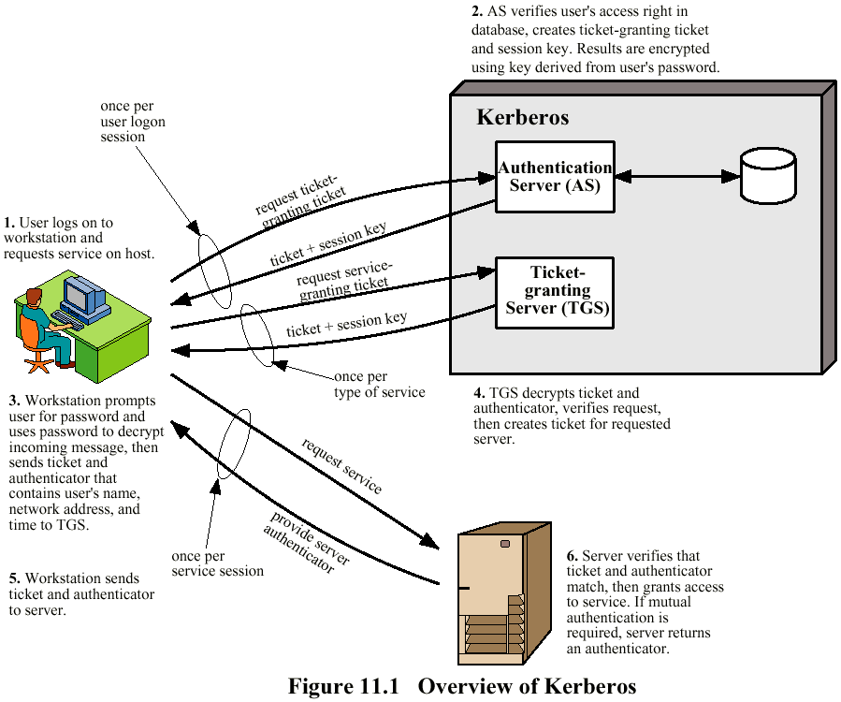

Slide 42
Kerberos version 4 – the final protocol
Still two problems remain
If the lifetime of the Ticket_{tgs} is too short, the user will be frequently asked for the password. With a to long lifetime, the opponent has a good opportunity fo r a replay. Similarly, the opponent can use a replay of a service-granting ticket if its lifetime is long.
There may be a need for the servers to authenticate themselves to users. Without such authentication the opponent could impersonate servers.
To solve the first problem, the AS provides both the client and TGS with a sevcret piece of informatio in a secure manner, in this case an encryption key K_{C,tgs}. The same idea is used with service-granting tickets.
The second problem is solved in the last step. By receiving the the last timestamp contents encrypted with session key, the client module is assured of the authenticity of the server.
The protocol is presented in table 11.1 and explained in table 11.2.

Slide 43
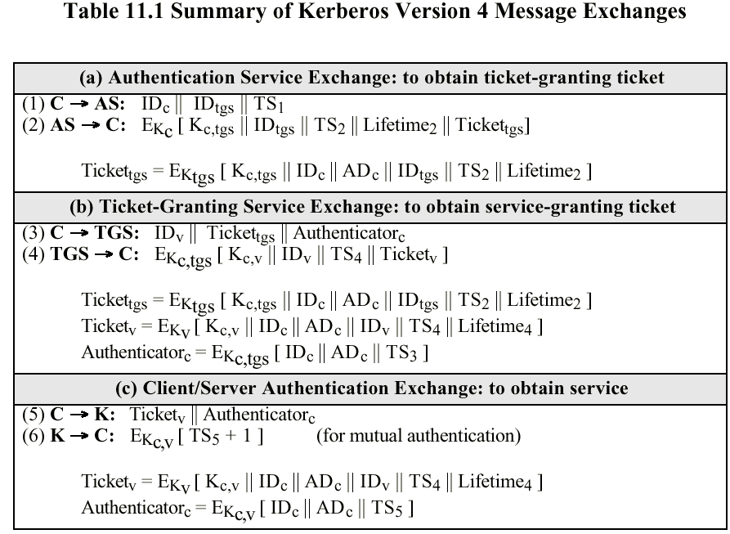

Slide 44
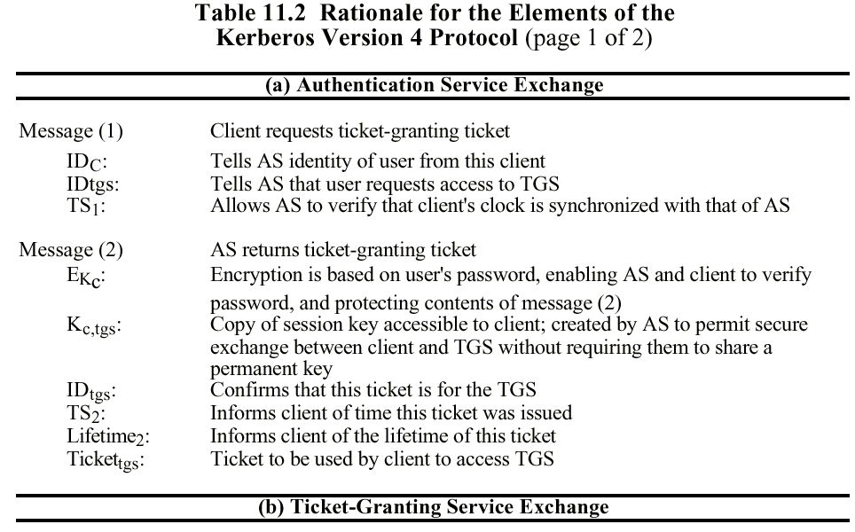

Slide 45
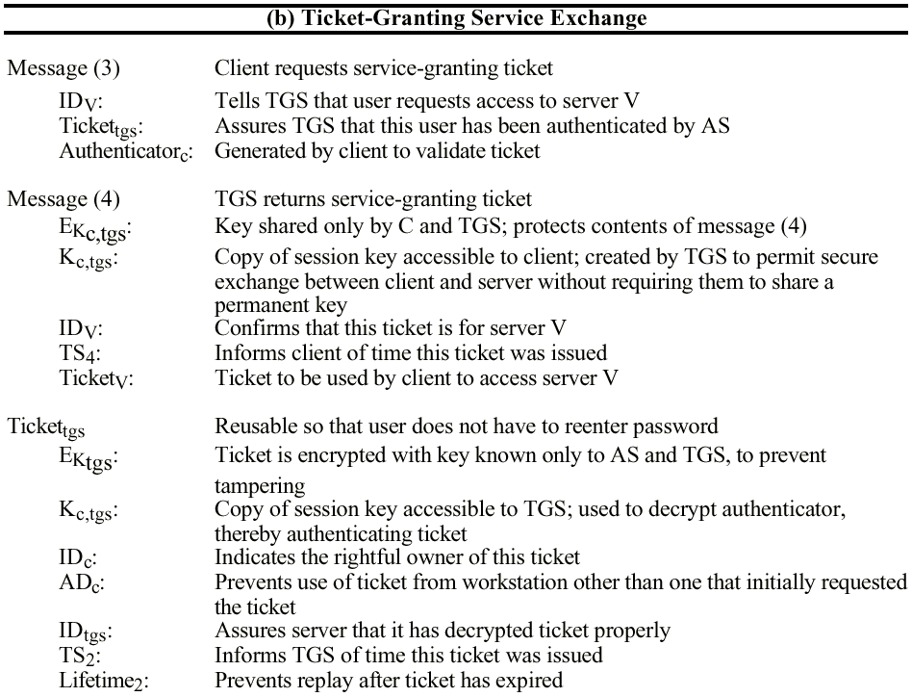

Slide 46
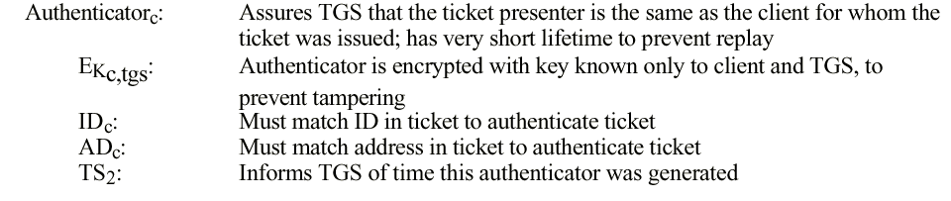

Slide 47
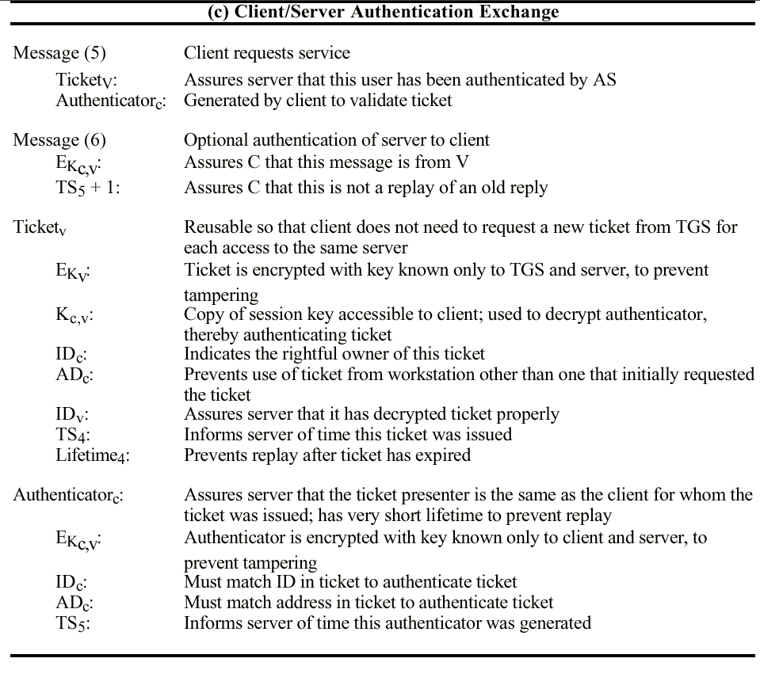

Slide 48
Kerberos realms and multiple Kerberi
A full-service Kerberos environment consisting of Kerberos server, a number of clients and a number of application servers requires the following:
The Kerberos server has the user Ids and hashed passwords of all participant users. All users are registered with the Kerberos server.
The Kerberos server shares a secret key with each server. All servers are registered with the Kerberos server.
Such an environment is referred to as Kerberos realm. Networks of clients and servers under different administrative organizations typically constitute diffirent realms.
Kerberos provides a mechanism for inter-realm authentication. If two realms support this, a third requirement is added
(3) The Kerberos server in each interoperation realm shares a secret key with the server in the other realm. The two kerberos servers are registered with the each other..
The use of multiple realms provides for the scalability of Kerberos.

Slide 49
